Slide 1
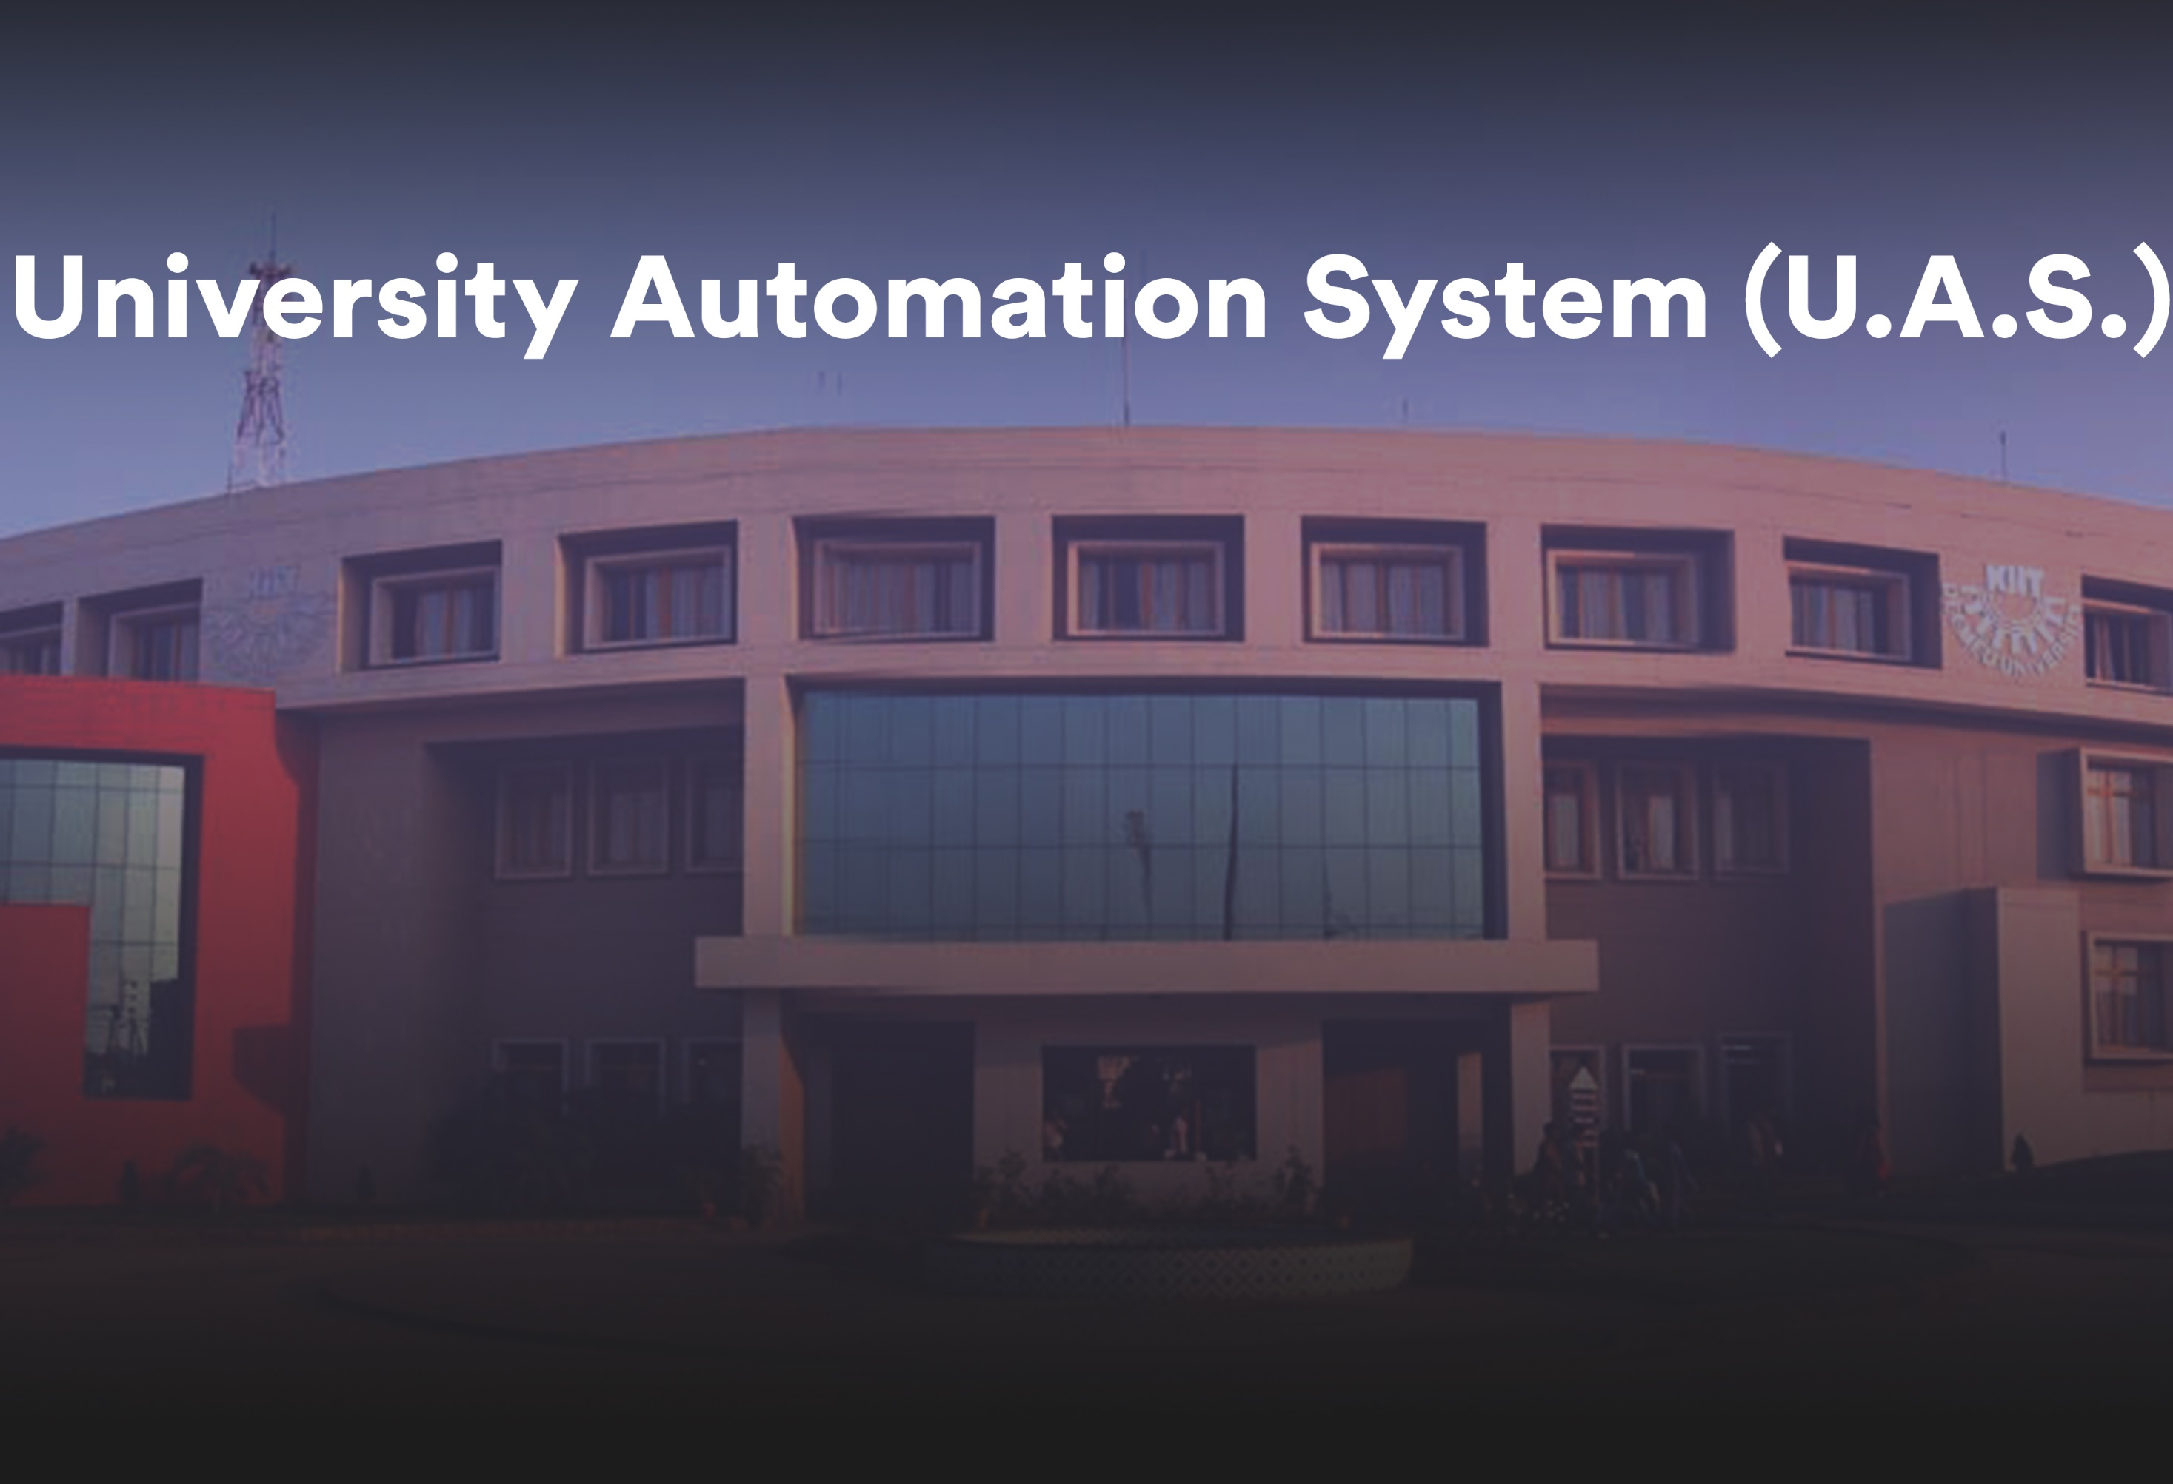
Presented by:
Srutisagar Sahu 1404151
Anant Kumar Mishra 1404169
Anshuman Dash 1404171
Ronak Biswajit Patnaik 1404210
Under the aegis of Prof. Ghanshyam Rout

Slide 2
Introduction
The impact of computers on our lives today is probably much
more than we are actually known to. In order to maintain
competitiveness in today’s global market, industry requires systems
that are capable of quickly responding to change while maintaining
stable and efficient operation. Automated software engineering
applies computation to software engineering activities. The goal is
to partially or fully automate these activities, thereby significantly
increasing both quality and productivity. This includes the study of
techniques for constructing, understanding, adapting and modelling
both software artefacts and processes

Slide 3
College automation is becoming a very essential component in education in this modern age. With the help of automation System we can gather all the useful information needed to the management in few clicks.
College Automation System consists of different modules such as student, faculty, admin etc. Our main purpose is to create a software which will manage the working of these different modules .
This system basically manages the information about various users including faculties, information about subjects offered in various semesters

Slide 4
Problem Statement
In existing system for managing various modules we need a lot of paper works as well as time for operation
Our motive is to develop a system for providing role based access to different users and reduce all the paper work

Slide 5
Design Cycle – Flow Chart
Problem Statement Ananlysis
Identifying the correct technology to use
Using Java Swing to design a desktop application for our solution
Using JDBC connecting a MySql database to desktop application to store the related data
Optimizing the code to take up less bandwidth while storing the data

Slide 6
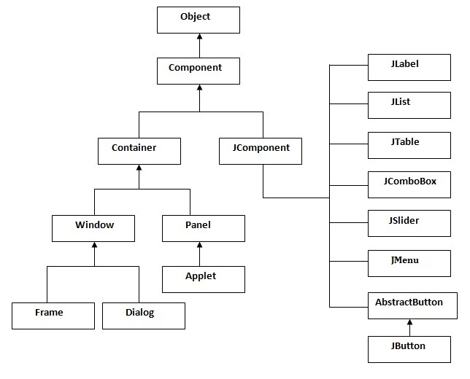
Graphical User Interface using Java Swings

Slide 7
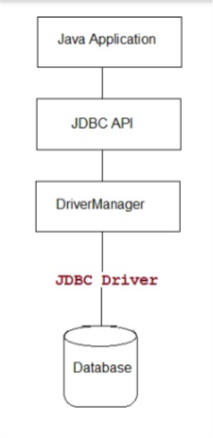
JDBC (Java Database Connectivity) connection to the GUI

Slide 8
User Friendly Experience
To the benefit of software and applications everywhere, UX has become an increasingly important step in the Software Development lifecycle. Even though UX is a slightly surreptitious layer of design, it’s no less important. It, by the nature of its name, defines the experience of the users.
These steps aren’t always possible to complete in the real world, but we need to cover all of them so that you’re aware when you can leave out certain steps and why. Sometimes you don’t necessarily leave out a step, but it is melded into another step, or replaced using a combination of experience, knowledge, and intuition.

Slide 9
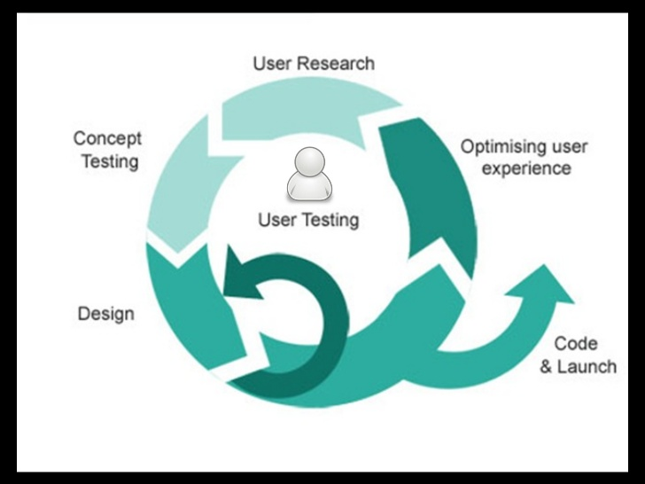
User Experience Process

Slide 10
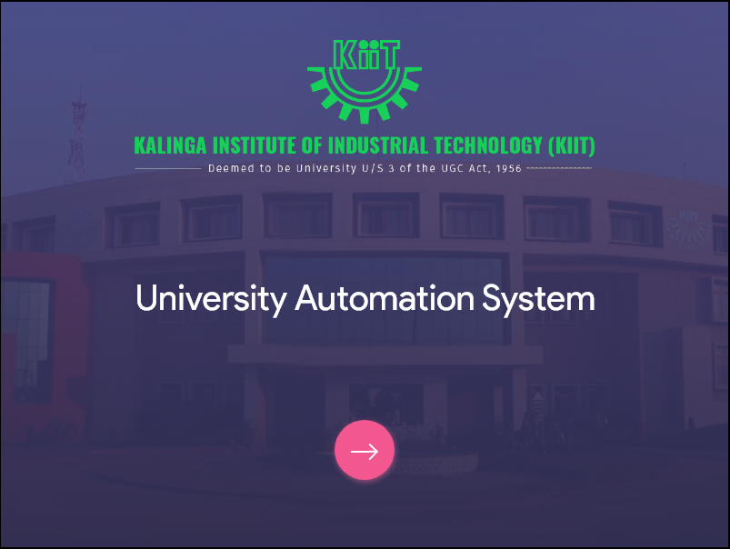
Work Idea

Slide 11
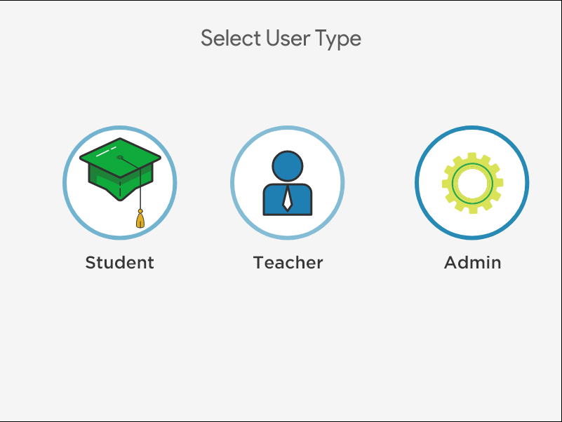
User Selection section

Slide 12
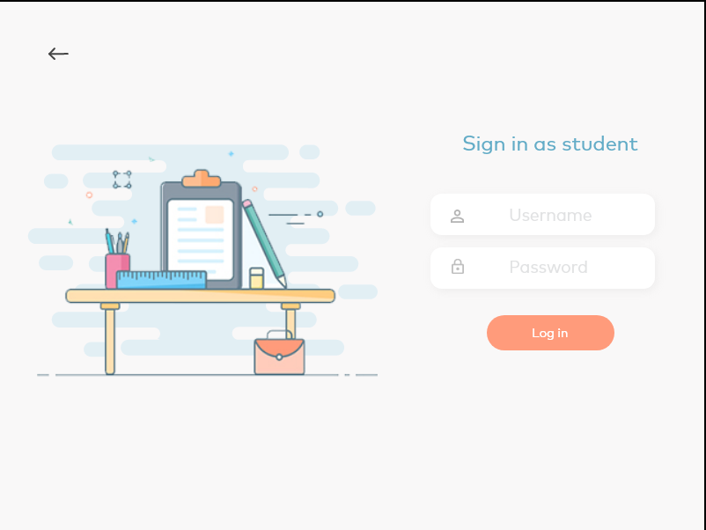
Student Login section

Slide 13
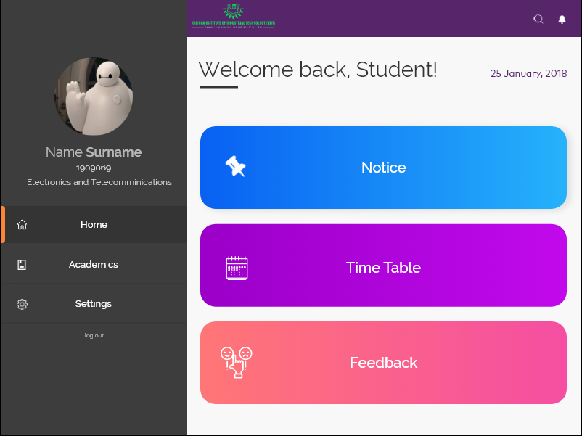
Student Dashboard

Slide 14
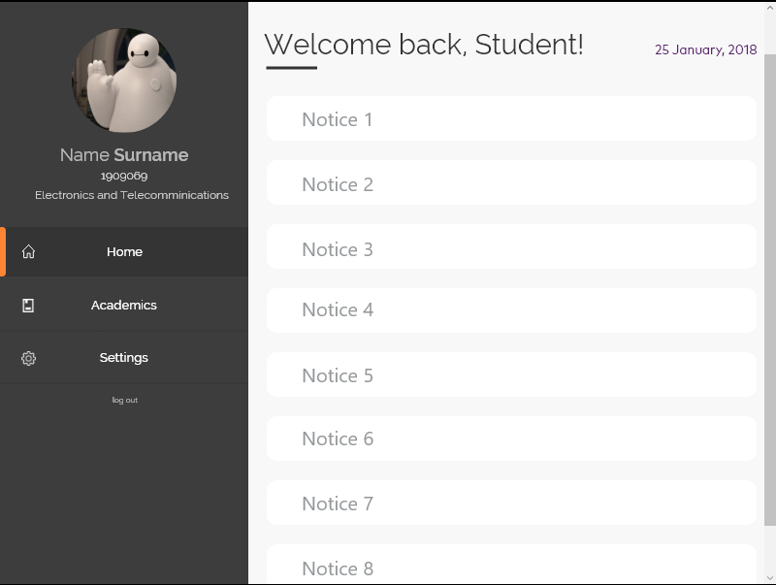
Notice Section

Slide 15
Future Work to be done
Teacher student feedback system
Time Table Portal
Mobile Application of the system
Real Time Chat system
Chat Bot
Interactive Academic Graph

Slide 16


